Slide 1

Understanding LLM Customization Techniques: Prompt Engineering, Fine-Tuning, and Retrieval-Augmented Generation
MMF Data Science Project
Nolan Lin, Yannis Zhang, Evelyn He, Lucas Lyu
Notes:
In this presentation, we are going to talk about the large language models, or LLMs. We will start by introducing the 3 main customizations techniques of LLMs, which are Prompt Engineering, Fine Tuning and RAG. Each technique offers their own advantages and challenges, and we will compare them in detail as well. Lastly, we will explore how these techniques can be applied in different scenarios, in order to effectively enhance the performance of LLMs

Slide 2
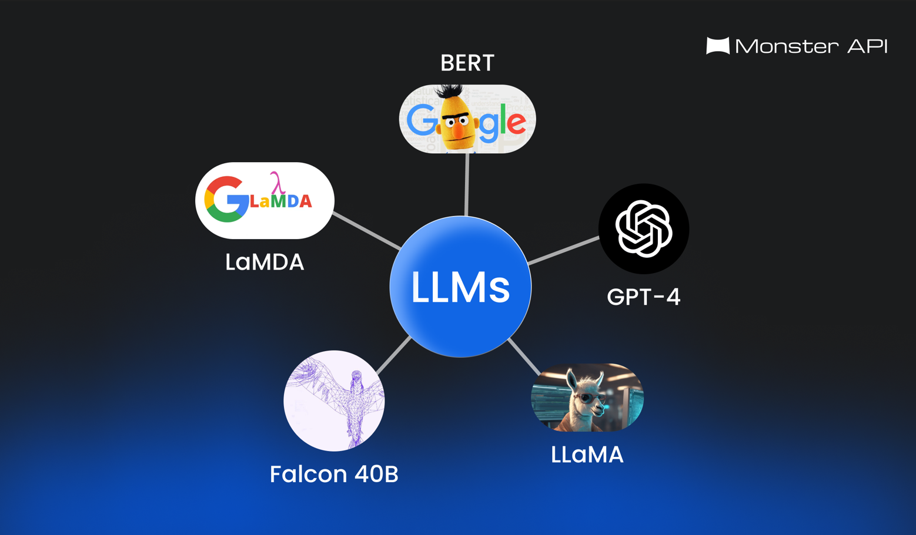

Introduction to Large Language Models (LLMs)
What Are LLMs?
AI models trained on vast internet data, capable of understanding and generating human-like text.
Power applications ranging from chatbots to analysis tools.
Why Customize LLMs?
Accuracy and Relevance: Adapting to fields like healthcare, legal, or social media.
Improving Performance: Out-of-the-box models are versatile but may not be accurate for specialized tasks.
Notes:
So Before we start, What is an LLM
LLM is a type of AI program that are trained on huge sets of data, allowing them to do a number of tasks. For example, models like ChatGPT and Google BERT, can recognize and generate human-like text.
And they can also been trained by more complex data to do other tasks, including writing in programming language, online search, or other analysis work.
However, the responses generated by these so-called out-of-the-box models can be very general because they rely solely on their initial training data.
To meet more specific requirement, such as how long you want the response to be? Or how deep you want the response to go to?, that's when customization comes into play
Therefore, Customizing LLM is crucial for the following reasons:
To generate responses that are more accurate and relevant to a specific field, such as in legal or medical field.
To improve performance on specialized tasks where Out-of-the-box models may not be sufficient to our need.
Now I will pass to Evelyn to go into the detail of the customization techniques.

Slide 3
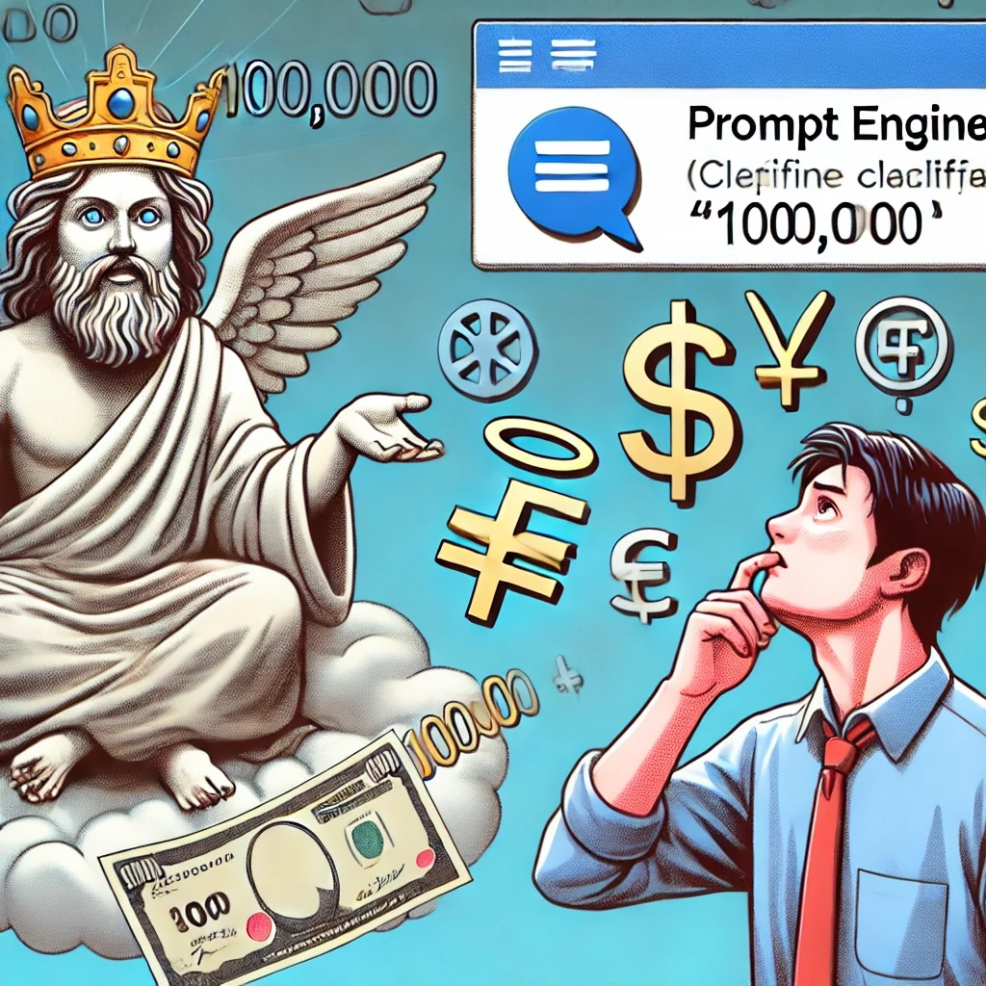
Prompt Engineering
Definition
Practice of crafting input queries or instructions to elicit more accurate and desirable outputs from large language models (LLMs).
How It Works
Create Prompt
Train Soft Prompts
Introduce Soft Prompts
Generate Better Reponse
Notes:
You may see the advertisement for job from a company, say they want a prompt engineer, so what is prompt engineering?
The formal definition is the practice of carefully designing and crafting the input prompts or examples provided to a language model, with the goal of eliciting desired outputs or behavior.
We can think of an example. You make a wish to god, like please giving me 1000 money.
Now, we did not specify the currency to god, god may give me 100,000 Japanese Yen, which is not I want, I want 100,000 dollars.
So the wish we made is like a prompt, and the god is ChatGpt. In order to make the goal we actually want, we need to make good prompt to Chatgpt. The Prompt Engineering is discussing how to make a better prompt
How it works Create a Prompt: You start with a prompt, which is like a question or a task instruction for the AI. For example, if you want the AI to summarize articles, your prompt might be: "Summarize the following text in a few sentences."
Introduce "Soft" Prompts: Prompt tuning introduces what are called soft prompts, which are not written in plain language but are instead learnable vectors (numerical representations) that are attached to the user's prompt. These vectors help guide the AI model to perform better on a specific task.
Train the Soft Prompts: Instead of training the entire model again, prompt tuning adjusts only these soft prompts. This tuning is much faster and less resource-intensive because it focuses only on the small prompts, not the entire model.
Generate Better Responses: Once trained, the model responds more accurately to that specific task because it has been "taught" how to handle similar prompts more effectively. The model itself doesn't change; only how it processes prompts does.

Slide 4
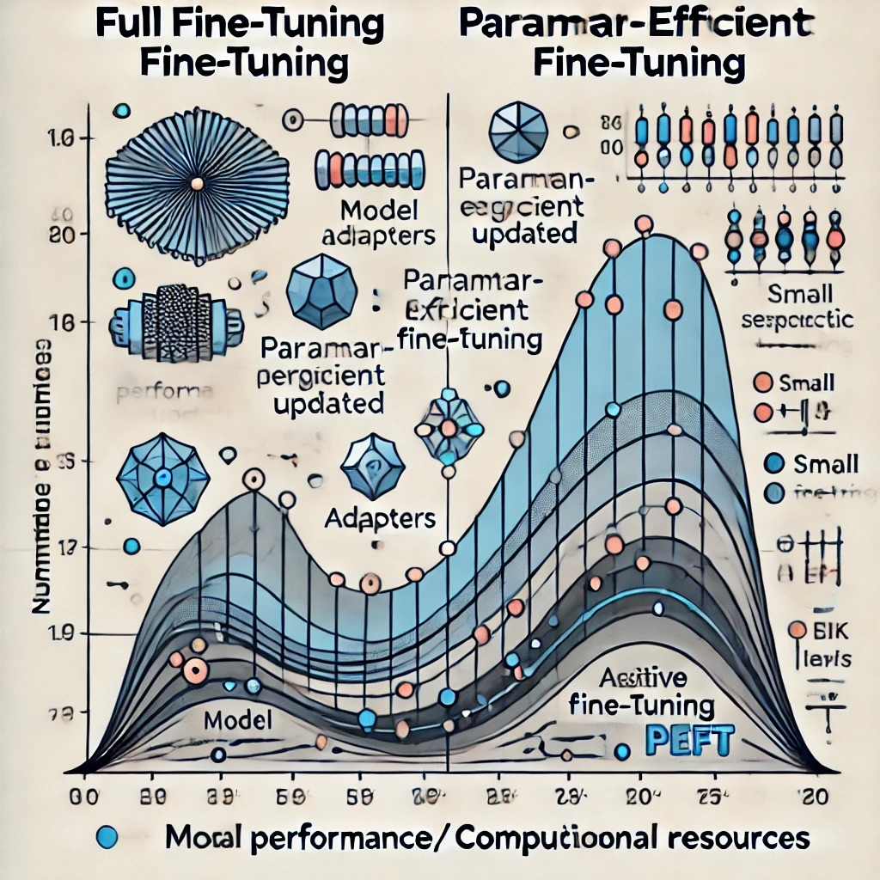
Fine-Tuning
Definition
Customization
Adapting a pre-trained model for specific tasks or use cases.
How It Works
Full Fine Tuning: Used to update the weights of the entire network
Parameter-efficient fine-tuning (PEFT): Alternate fine-tuning methods
Notes:
Introduction
Fine-tuning in machine learning is the process of adapting a pre-trained model for specific tasks or use cases.
It's easier and cheaper deep learning models with millions or even billions of parameters, like the large language models (LLMs). Linton will give more specifically on this part.
How it works
We can have two kinds of ways doing it - one is called full fine-tuning, the other is Parameter efficient fine-tuning (PEFT)
Full-Time Tuning
Fine-tuning can be used to update the weights of the entire network(also called , but for practical reasons this is not always the case.
Parameter-efficient fine-tuning (PEFT)
Parameter-efficient fine-tuning (PEFT). This method updates only a select subset of model parameters.

Slide 5
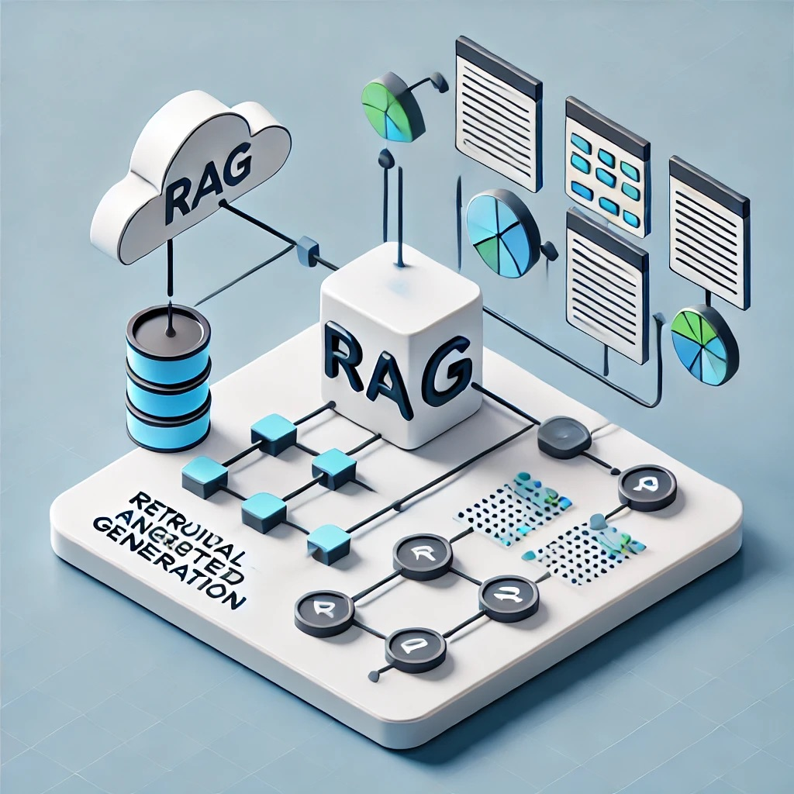
Retrieval-Augmented Generation (RAG)
Definition
Combines retrieval of relevant data from an external source with text generation.
Improves model output by incorporating real-time information.
How It Works
Retrieval: Searches a database for relevant data.
Augmented Generation: Uses retrieved data for more accurate responses.
Notes:
Introduction
RAG (Retrieval-Augmented Generation) is an AI method that combines two powerful techniques: retrieving information from external sources and generating responses using that information.
How it Works:
Retrieval: When asked a question, the AI first looks for relevant information by searching a large database or knowledge base. This is similar to how we would Google something or look up facts in a book.
Augmented Generation: Once the AI has found this information, it uses a language model (like GPT) to generate a response. But instead of just making something up based on what it already knows, it incorporates the newly retrieved data into its answer.
It’s improves a LLM to a better answers by pulling in relevant data from outside databases and then using that data to create more accurate responses.

Slide 6



Comparison
Techniques | Pros | Cons
Prompt Engineering | Easy Cost-effective Flexible | Limited to model's knowledge Inconsistent output
Fine-Tuning | Highly accurate Domain-specific | High cost Data intensive Technical expertise
RAG | Easier Up-to-date info Balanced output | Requires retrieval integration Data Dependency
Notes:
Prompt Engineering
This process, known as prompt engineering, is similar to asking the right questions to get the best answers. However, the model's responses are limited to what it learned during its original training, meaning it can only retrieve pre-learned information.
Output quality varies based on the phrasing of prompts.
Fine-tuning
Fine-tuning involves customizing an LLM by updating it with new information or specialized data, similar to installing a software update to unlock new features. This process enhances the model’s understanding of specific topics but requires significant computing power and time.
Handles topics not covered in the original training.
Significant computational resources
Technical expertise, deeper knowledge of machine learning
RAG (Retrieval Augmented Generation)
RAG combines the capabilities of language models with external knowledge bases. When the model receives a query, it first retrieves relevant data from an external database, then generates the answer based on the combined information. It works like checking a library for the latest information before responding.
Easier than fine-tuning but more powerful than basic prompting.
Requires retrieval system with external system
The quality of answers depends on the relevance of retrieved information.

Slide 7
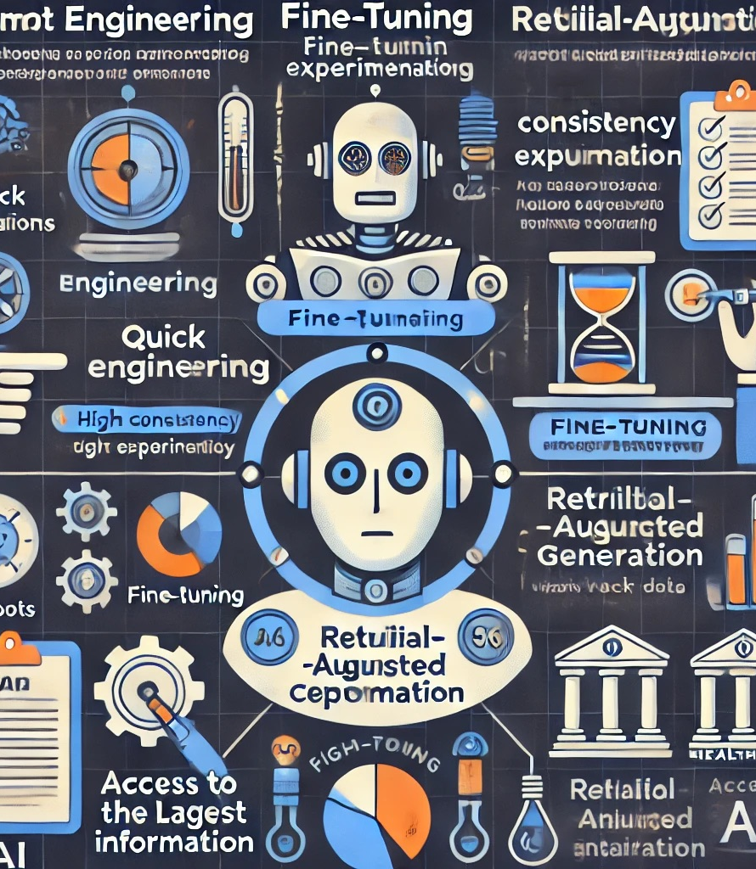
Use Case
Prompt Engineering:
Ideal for quick adjustments without training
Best for general, adaptable tasks (e.g., customer service chatbot)
Fine-Tuning:
Suitable for tasks needing high accuracy in specialized domains
Provides consistent, domain-specific responses (e.g., legal, medical analysis tools)
Retrieval-Augmented Generation (RAG):
Integrates real-time, dynamic data
Ideal for tasks needing current, relevant info (e.g., finance advisory tool)
Notes:
When to Use Each Technique (Use Case)
Now, let's get into the decision-making process for choosing the right customization technique depending on use case.
· If you need quick, efficient adjustments without dealing with complex model training, prompt engineering is a great starting point. For example, let’s say you’re developing a chatbot for general customer service. Here, by crafting precise prompts, you can guide responses without needing extensive resources, making prompt engineering the go-to choice
· Fine-tuning is best when your application requires high consistency and accuracy, especially in specialized domains. For instance, in a legal analysis tool, where every response needs to reflect precise legal terminology and knowledge, fine-tuning the model on legal-specific texts would be the best choice.
· RAG is optimal when your application needs access to the latest information. Take, for example, a finance advisory tool that constantly updates users on stock trends. Using RAG, the model can retrieve up-to-date market data in real-time, enhancing relevance and accuracy.

Slide 8
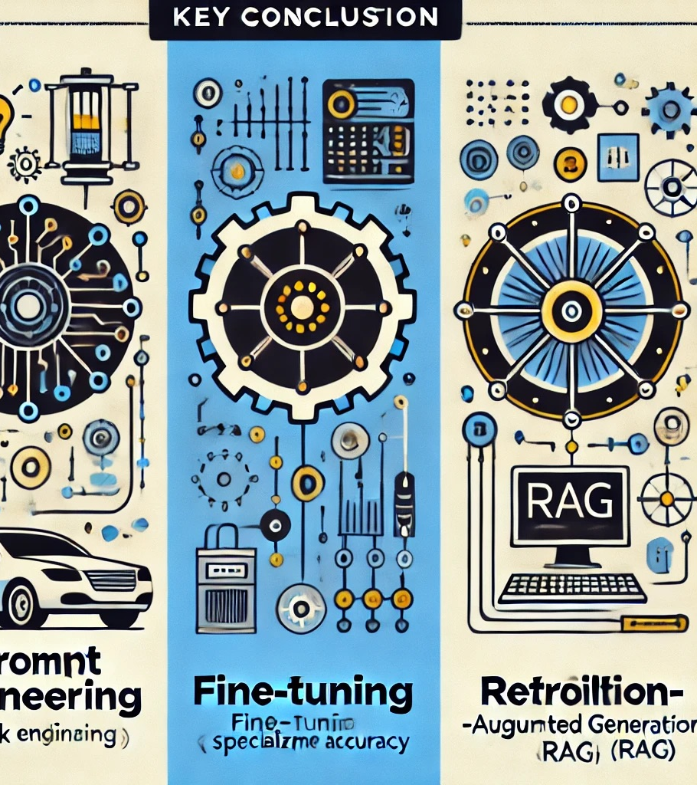
Conclusion
Prompt Engineering: Fast and cost-effective but relies on existing model knowledge
Fine-Tuning: Highly accurate and specialized but resource-intensive
RAG: Adds real-time knowledge but requires complex integration
Future Potential:
Hybrid approaches combining these techniques expand capabilities
Example: Fine-tuning for domain-specific understanding + RAG for real-time updates
Notes:
Conclusion
To wrap up, let's summarize the key differences in these techniques:
Prompt Engineering provides rapid, cost-effective adjustments, but relies solely on the model’s existing knowledge.
Fine-Tuning offers a deeper, customized model adaptation, well-suited for specialized tasks, though it requires more technical resources and time.
RAG bridges the gap between static knowledge and dynamic updates, integrating external information when up-to-date responses are critical.
As the field evolves, we’re seeing the potential for hybrid approaches, where models might use a combination of prompt engineering, fine-tuning, and RAG to achieve even more tailored results.
This marks the end of our presentation,(next slide)

Slide 9
Q&A
Reference
K2View. (n.d.). RAG vs Fine-Tuning vs Prompt Engineering. Retrieved from https://www.k2view.com/blog/rag-vs-fine-tuning-vs-prompt-engineering/#RAG-vs-fine-tuning-vs-prompt-engineering-compared
CrucialBits. (n.d.). LLM Customizations: Prompt Engineering, RAG, Fine-Tuning. Retrieved from https://crucialbits.com/blog/llm-customizations-prompt-engineering-rag-fine-tuning/
IBM. (n.d.). Fine-Tuning. Retrieved from https://www.ibm.com/topics/fine-tuning
RAG vs Fine-Tuning vs Prompt Engineering (n.d.) Retrived from https://www.k2view.com/blog/rag-vs-fine-tuning-vs-prompt-engineering/#RAG-vs-fine-tuning-vs-prompt-engineering-compared
LLM customizations: Prompt Engineering, RAG & Fine-Tuning (n.d.) Retrived from https://crucialbits.com/blog/llm-customizations-prompt-engineering-rag-fine-tuning/
Notes:
now it’s the Q and A time, we would welcome any questions or comments from you guys!

